Slide 1

Results of Management Strategy Evaluation (MSE) for [X]
  Author - Updated May 2020

Slide 2

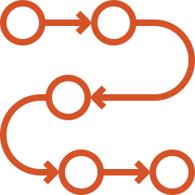
MSE Explained
The What
A simulation-based, analytical framework used to evaluate the performance of multiple harvest strategies relative to the pre-specified management objectives
The Why
The process for developing harvest strategies that are robust to uncertainty

Slide 3




A Brief Overview of Harvest Strategies
  A pre-agreed framework for making management decisions
  Also referred to as “management procedures”
  Evaluated and selected using MSE
  Three main elements
        Monitoring data with collection plan
        Analysis method
        (ex: stock assessments; CPUE calculations)
        Harvest control rule (HCR) tuned to reference points

Slide 4
Harvest Strategies in Development

Slide 5
Roles and Responsibilities
  Harvest strategy development is a dynamic collaboration between scientists, managers, and
  other stakeholders
Scientists
Managers
Set management objectives
Characterize uncertainties
Decide on acceptable level of risk
Propose candidate reference points
Stakeholder
involvement
Select final reference points
Propose candidate HCRs
Select final candidate HCRs to evaluate with MSE
Evaluate candidate HCRs using MSE
Provide final feedback on MSE
Complete HCR evaluation using MSE
Adopt & implement final HCR and harvest strategy

Slide 6
Benefits of Harvest Strategies
  Increase transparency, predictability and market stability
  Avoid costly and highly politicized negotiations
  Facilitate swift, efficient management to ensure resource health and industry profitability
  Effectively implement the precautionary approach (UNFSA, MSC)
  Comply with [X mandate of Y RFMO]

Slide 7

Benefits of MSE
  Helps to identify the management plan most likely to achieve vision for the fishery
  Offsets the uncertainty and natural variability inevitable in fisheries management
  Balances trade-offs among
  competing management objectives
  Accounts for risk
  Helps to prioritize data needs
  and research

Slide 8

Management Objectives for this MSE
  [Insert pre-agreed MOs, including reference points & acceptable levels of risk, if possible to do it in one slide]
  Maintain stock at a sustainable level
  Avoid dangerously low stock levels
  Maximize catch
  Maximize stability in interannual catch levels

Slide 9

Performance Metrics for this MSE
  [Insert table of performance metrics for each MO]
  Maintain stock at a sustainable level
Minimum biomass relative to B_{MSY}
Mean biomass relative to B_{MSY}
Mean fishing mortality relative to F_{MSY}
Probability of being in the Kobe green quadrant
Probability of being in the Kobe red quadrant
  Avoid dangerously low stock levels
  Maximize catch
  Maximize stability in interannual catch levels

Slide 10
Performance Metrics for this MSE
  [Insert table of performance metrics for each MO]
  Maintain stock at a sustainable level
Probability that biomass is above B_{lim}
Probability of B_{lim}<B<B_{thresh}
  Avoid dangerously low stock levels
  Maximize catch
  Maximize stability in interannual catch levels

Slide 11
Performance Metrics for this MSE
  [Insert table of performance metrics for each MO]
  Maintain stock at a sustainable level
  Avoid dangerously low stock levels
Mean catch over years 1-5
Mean catch over years 5-15
Mean catch over years 15-30
  Maximize catch
  Maximize stability in interannual catch levels

Slide 12
Performance Metrics for this MSE
  [Insert table of performance metrics for each MO]
  Maintain stock at a sustainable level
  Avoid dangerously low stock levels
  Maximize catch
Mean absolute proportional change in catch
Variance in catch
Probability of TAC change over a certain level
Maximum amount of TAC change between management periods
  Maximize stability in interannual catch levels

Slide 13
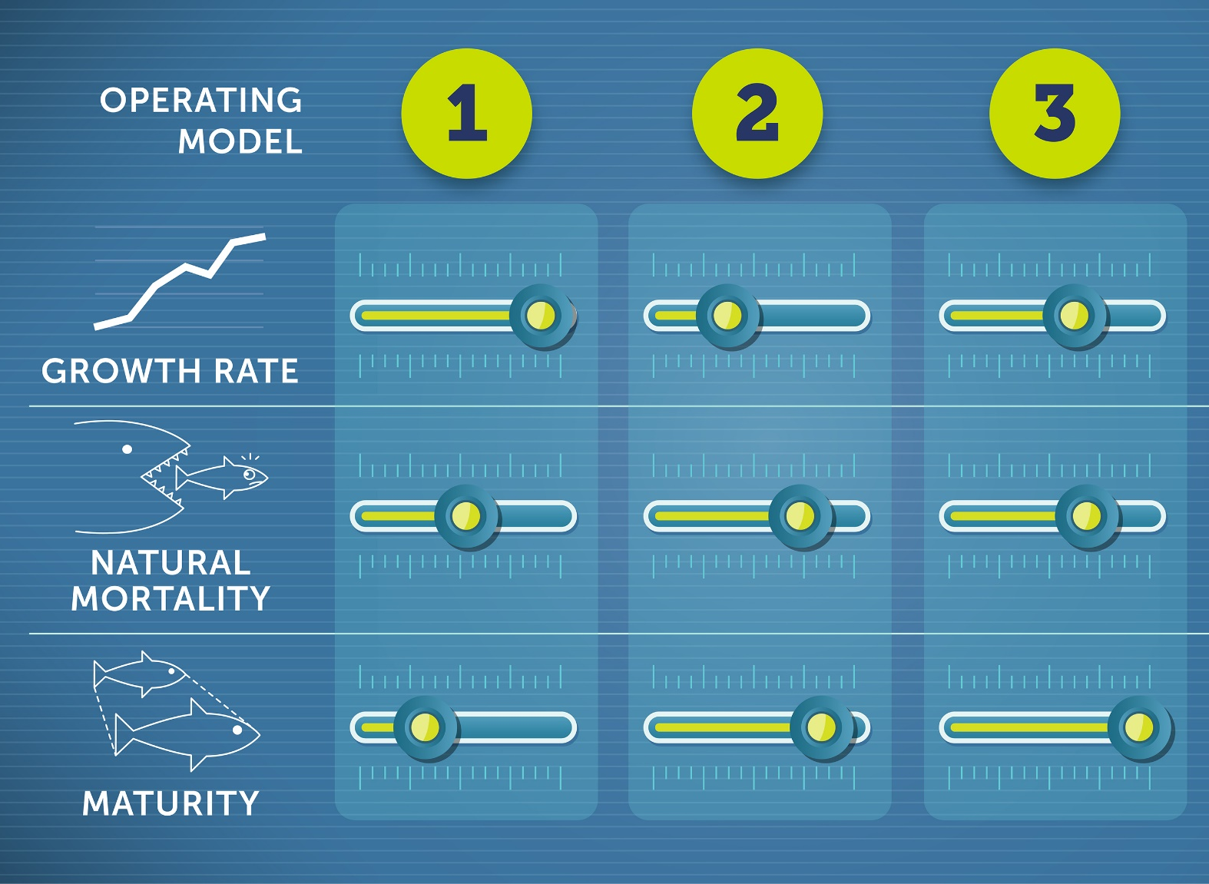
Operating Models
  Operating Models (OMs) are at
  the center of the MSE modelling framework. They:
        Represent the “real world”
        in the simulation
        Include all plausible hypotheses about the biology
        of the stock (ex: recruitment)
        and fishery dynamics (ex: the level of illegal fishing activity)
        Many combinations of hypotheses lead to many OMs

Slide 14
OMs for this MSE
  [Insert uncertainty grid]
Category of key uncertainties
A (e.g., Steepness)
B
C
D
E
F
G
H

Slide 15
OMs for this MSE (continued)
  TOTAL NUMBER
  OF OMs
  [Insert reference set of OMs, highlighting total number of OMs]
  [Insert robustness set of OMs, highlighting total number of OMs]
  [Highlight any plausibility weighting of OMs]
  1000
  100

Slide 16


Closed Loop Simulation to
Test Candidate Harvest Strategies
  Click next to play video

Slide 17
Candidate Harvest Strategies Tested in this MSE
  [Insert list of candidate HS, including data inputs & HCR forms; use multiple slides if necessary]

Slide 18
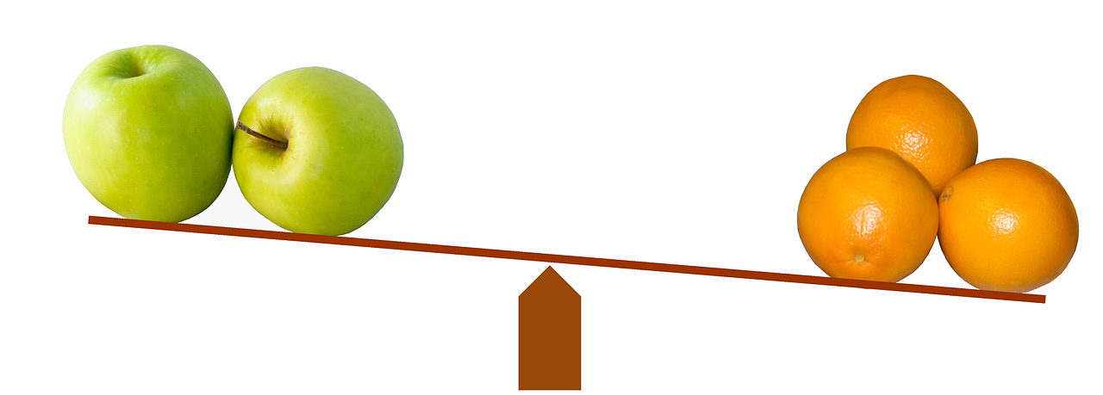
Tuning
  By selecting one performance standard for all candidate harvest strategies, the relative performance against the other management objectives can be compared.
  [Insert tuning standard for this MSE]

Slide 19
Performance
Comparison
MP1-MP5. Median values over
20-year projection (2020-2040).*
MANAGEMENT PROCEDURE Overall scores (average of 6 performance metrics)
Best scores
HIGHEST SCORE
MP1
MP3
MP2
MP1
MP3
MP2
MP5
MP4
SUMMARY OF RESULTS
Management procedure 1 (MP1) performs best, scoring well for all 6 performance metrics over the 20-year projection period. MP3 also scores highly but with less stability in catches from year to year. MP2 performs well for yield-related metrics at the sacrifice of population health.
PERFORMANCE METRICS
>Blim
Notes
Maximizing catch in the short-term has a tradeoff of increasing the likelihood of the population declining below the limit reference point.
MP2 has the lowest interannual variation in catch, making it the most stable MP, while MP4 has the most variation and least stability.
3
1
5
4
2
RANKING OF MPs BY THIS PERFORMANCE METRIC
A
Net revenue
pGreen
B
READING THIS CHART
This chart compares the performance of 5 management procedures (MP) against 6 performance metrics.
Each value is a median for X operating models over 20 years in the projection period 2020-2040.
The filled hexagons on top represent an average score of all performance metrics for each management procedure. It provides a quick comparison of overall MP performances. Larger areas indicate better overall performance.
The lines in the bottom spider plot connect individual scores for the performance metrics in each management procedure. Scores closer to the exterior edge indicate better performance.
3
1
5
4
2
3
1
5
4
2
3
1
5
4
2
3
1
5
4
2
Catch after 30 years – long-term
Interannual variation in yield
Glossary
Blim Biomass limit reference point
pGreen Probability that the population is not overfished and not subject to overfishing (i.e., in the green quadrant of the Kobe plot)
3
1
5
4
2
*The plot can also be used to show the results at the end of the projection period.
Catch after 3 years – short-term

Slide 20
Performance
Comparison
MP1-MP5. Median values over
20-year projection (2020-2040).
MANAGEMENT PROCEDURE
Best scores
MP1
OVERALL SCORES (average)
MP3
MP2
SUMMARY OF RESULTS
Management procedure 1 (MP1) performs best, scoring well for all performance metrics over the 20-year projection period except short-term catch, a necessary tradeoff to ensure long-term population health. MP3 also scores highly, particularly for long-term catch and avoiding the limit reference point, but with much lower short-term catch, less stability in catches from year to year and a lower chance of being in the Kobe green quadrant. MP4 performs well for short-term yield at the sacrifice of population health.
PERFORMANCE METRICS WITH
SIGNIFICANT DIFFERENCES ACROSS MPs
HIGHEST SCORE
PERFORMANCE METRICS
Net revenue
pGreen
Interannual variation in yield
Catch after 3 years – short term
READING THIS CHART
This chart compares the performance of 5 management procedures (MP) against 10 performance metrics.
Each value is a median for X operating models over 20 years in the projection period 2020-2040.
The large dots represent the average score for all performance metrics in each management procedure. It provides a quick measure of overall MP performance.
Small dots represent individual scores for performance metrics in each management procedure.
Scores on the right side of the scale indicate better performance.
Performance metrics with the largest differences across MPs are shown first as they may be key to assessing and choosing a MP.
Catch after 30 years – long term
>Blim
PERFORMANCE METRICS WITH NO
SIGNIFICANT DIFFERENCES ACROSS MPs
Minimize bycatch
Equitable fishing opportunities
Glossary
Blim Biomass limit reference point
pGreen Probability that the population is not overfished and not subject to overfishing (i.e., in the green quadrant of the Kobe plot)
CPUE
Food security

Slide 21
Projection of trade-off between catch and biomass
MP1-MP6 over 2020-2040 period.
Best scores
HIGHEST SCORE
MP3
FMSY
MP2
MP4
MP3
BMSY
MP2
MP4
12.5%
SUMMARY OF RESULTS
Management procedure 3 (MP3) performs best, with the highest probability of being in the green quadrant of the Kobe plot (i.e., not overfished, no overfishing) over the
20-year projection period. MP2 also performs well but with a higher probability of being in the orange (i.e., overfished, no overfishing). MP5 performs poorly, likely to remain in the red quadrant of the Kobe plot (i.e., overfished, no overfishing) for nearly the entire projection period.
87.5%
MP6
MP1
MP5
READING THIS CHART
This chart compares and ranks projected median values for X operating models over time for six management procedures and shows the level of uncertainty. Segments within each bar are another way of looking at the error bars in the Kobe plot. They show the percentage of runs that fall in each of the Kobe quadrants in each projection year. The probability of being in the green quadrant should be ≥60%, a common management objective.
UNCERTAINTY
MEDIAN OF OTHER MPs
THIS MP
LAST PROJECTION YEAR

Slide 22
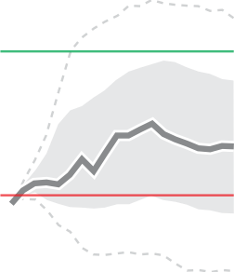
Stock size projection
Historical data (1950-2016) and projections for MP1-MP5, plus Zero-Catch (2017-2040). Index (1950=100%).
Best scores
SUMMARY OF RESULTS
Management procedure 2 (MP2) performs best, maintaining biomass around the target reference point and well above the limit reference point over the 20-year projection period. MP3 also performs well, with projected biomass remaining well above both the target and limit reference points over the 20-year projection period, but it is ranked lower than MP2 since it is unnecessarily higher than the target. MP1, MP4, and MP5 are not suitable options as biomass is projected to be consistently below the target reference point.
READING THIS CHART
The chart compares projected stock size over time for six management procedures, and level of uncertainty across different simulation runs of a particular operating model.*
MP2
MP3
MP4
10th-90th PERCENTILE
TARGET
25th-75th PERCENTILE
MEDIAN
LIMIT
HISTORICAL: 1950-2016
PROJECTION: 2017-2040
Management procedures (MP)
HIGHEST MP SCORE
ONE BY ONE
Zero Catch
MP3
MP2
MP4
MP5
MP1
ALL COMPARED
MP2 also performs well since it maintains biomass at or above the target, with a very low probability of breaching the limit.
*This chart type can also be used to show results averaged across all operating models.

Slide 23
Trade-off: catch/biomass
Six management procedures (MP1-MP6). Median in final year of 2020-2040 projection.
Best scores
MP2
MP3
SUMMARY OF RESULTS
Management procedure 2 (MP2) and MP3 perform best, maintaining the stock around B_{MSY} while fishing around the target reference point. While MP4 and MP6 also project a sustainable stock, fishing effort is lower than necessary. The failure of MP5 stems from severe overfishing, resulting in an overfished stock.
RESULTS RANKING
HIGHEST SCORE
MP3
Stock around B_{MSY} and effort around F_{TARGET}
MP2
MP4
Sustainable stock but low fishing
MP6
MP1
Effort around F_{MSY} but low stock
MP5
Overfishing, jeopardizing stock sustainability
READING THIS CHART
The chart compares trade-offs in six management procedures (MPs) for X operating models by measuring two co-dependent performance metrics: fishing mortality (vertical axis) and biomass (horizontal axis).
Index (1 = target)
The dots represent the median value for the final year of the projected period 2020-2040. Dotted lines around dots are error bars representing 90th percentiles.
Performance metrics measured
F/F_{MSY} Fishing mortality relative to fishing at maximum sustainable yield.
SB/SB_{MSY} Spawning biomass relative to the spawning biomass that enables a fish stock to deliver the maximum sustainable yield.

Slide 24
Trade-off and performance: catch/biomass
Three management procedures
(MP1-MP3). Median values over
20-year projection period (2020-2040).
Best scores
MP1
MP2
MP3
MP3
C_{av}
AAV
B_{final}
B_{lowest}
CATCH
ABUNDANCE
^{C}av
Average annual catch over the projection period.
AAV
Average percent change in catch from year to year.
^{B}final
Biomass relative to unfished biomass at the end of the projection period.
^{B}lowest
Lowest value of projected biomass during the projection period.
SUMMARY OF RESULTS
Management procedure 3 (MP3) scores best for biomass-related metrics over the 20-year projection period. MP1 and MP2 score higher for yield-related metrics, at the sacrifice of population health.
Lower is better
(fishery is stable)
Higher is better
(if resource is stable)
Higher is better
(resource status healthy)
Higher is better
(low risk, safer resource)
READING THIS CHART
Key
Management procedure MP1 MP2 MP3
Zero future catches (largest possible recovery within projection period)
The chart compares performance of different candidate management procedures (MP) across X operating models, showing trade-offs between actionable metrics of catch (2 performance metrics on the left) and resulting biomass or fish abundance (2 performance metrics on the right).
How a box plot works
HIGHEST VALUE
3RD QUARTILE
MEDIAN FOR 20-YEAR PROJECTION
1ST QUARTILE
LOWEST VALUE
SPREAD 50% OF ALL VALUES
FALL WITHIN THIS RANGE

Slide 25
Trade-off and performance: catch/biomass
Three management procedures
(MP1-MP3). Median values over
20-year projection period (2020-2040).
Best scores
MP3
Performance metric
Operating model
1
2
3
4
5
6
7
8
9
10
11
12
CATCH
^{C}av
Average annual catch over the projection period.
SUMMARY OF RESULTS
Performance varies across the individual operating models (OMs), but overall, management procedure 3 (MP3) performs best, scoring well for all 4 performance metrics across the 12 operating models over the 20-year projection period. For almost all OMs, MP3 does not allow biomass to decline as much as the other MPs, and it also leads to the greatest stability in catches.
AAV
Average percent change in catch from year to year.
READING THIS CHART
ABUNDANCE
Key
Management procedure
MP1 MP2 MP3
Zero future catches (largest possible recovery within projection period)
^{B}final
Biomass relative to unfished biomass
at the end of the projection period.
The chart compares performance of different candidate management procedures (MP) showing trade-offs between actionable metrics of catch
(2 performance metrics on top) and resulting biomass or fish abundance (2 performance metrics on the bottom). 12 different operating models are compared.
^{B}lowest
Lowest value of projected biomass during the projection period.
BEST SCORING MP
HIGHEST VALUE
MEDIAN FOR
20-YEAR PROJECTION
LOWEST VALUE

Slide 26
Performance
Comparison
MP1-MP5 for different operating models. Median values over 20-year projection (2020-2040).*
Best scores
MP3
MP2
MP5
SUMMARY OF RESULTS
Management procedure 3 (MP3) performs best, scoring well for all 6 performance metrics across the 12 operating models over the 20-year projection period. MP2 also scores highly. MP1 and MP4 perform well for the short-term catch metric at the sacrifice of population health.
Management procedure
Performance metrics measured
MP1
MP2
MP3
MP4
MP5
A
A
>Blim means the stock biomass is above the limit reference point (indicator of abundance).
pGreen gives the probability that the stock is not overfished or subject to overfishing (indicator of fishery status).
Interannual variation in yield gives the percent change in catch from year to year (indicator of stability).
Catch after 3 years - short term gives the short-term catch (indicator of yield).
Catch after 30 years - long term gives the long-term catch (indicator of yield).
Net revenue gives the annual fishery profits (indicator of abundance).
F
B
B
C
E
C
D
D
E
F
Operating model
READING THIS CHART
This chart compares performance
of
6 performance metrics
in
5 management procedures (MP)
for a set of
12 operating models (columns)
Each value is a median over a 20-year projection period.
The hexagon edges in each chart connect individual scores for the performance metrics in that management procedure. Points closer to the exterior edge indicate better performance.
The percentages represent an average score of all performance metrics in each management procedure. It provides a quick comparison of overall MP performances. Filled hexagons with larger areas indicate better overall performance.
1
2
3
4
5
6
7
8
9
10
11
12
Best scoring MP in each model
OVERALL MP SCORE
HIGHEST SCORE FOR THIS PERFORMANCE METRIC IS IN THIS OPERATING MODEL
X%

Slide 27
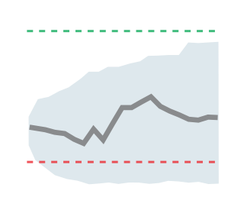
Stock size projection
Historical data (1980-2020) and projections for MP1-MP6, plus Zero-Catch (2021-2040). 10 operating models.
Best scores
SUMMARY OF RESULTS
Management procedure 1 (MP1) performs best, with projected biomass fluctuating at or above the target reference point over the 20-year projection period in nearly every operating model (OM). MP2 also scores highly, particularly under OM 6, but projects biomass to be consistently below the target reference point in 4 OMs. MP6 is likely to fail, with biomass consistently below both the target and reference points.
MP1
MP2
Management procedure
READING THIS CHART
The chart compares projected
stock size over 20 years for six management procedures and a zero catch option in 100 simulations by 10 operating models.
HISTORICAL:
1980-2020
PROJECTIONS:
2021-2040
MP1
MP2
MP3
Zero catch
MP4
MP5
MP6
TARGET
10th-90th PERCENTILE
MEDIAN FOR EACH MP
LIMIT
Operating model
1
2
3
4
5
6
7
8
9
10
HIGHEST MP
LOWEST MP

Slide 28
Summary Table of MSE Results
  [Insert summary table of MSE results]
Management Procedure | Performance Measure
Management Procedure | SB/SB_{MSY} | Probability (Green) | Probability (SB>limit) | Mean Catch | Catch variability
MP1 | 0.78 | 0.05 | 0.84 | 516 | 0.16
MP2 | 1.33 | 0.94 | 0.96 | 383 | 0.28
MP3 | 1.48 | 0.96 | 1 | 358 | 0.3
MP4 | 1.21 | 0.84 | 0.93 | 419 | 0.22
MP5 | 0.72 | 0 | 0.71 | 611 | 0.1
MP6 | 1.11 | 0.51 | 0.91 | 452 | 0.21

Slide 29
Key Results
  [Insert main findings from MSE on relative performance of candidate harvest strategies]

Slide 30
Exceptional Circumstances
  Triggered when:
        Stock or fishery dynamics get outside of the ranges tested by the MSE; or
        Extreme environmental regime shift occurs; or
        Absence of data makes it impossible to estimate stock status and/or apply
        the agreed harvest strategy
      Managers must pre-agree what happens if exceptional circumstances are triggered, both for near-term management and future of harvest strategy
      [Insert exceptional circumstances indicators/decision tree for this MSE, if available]

Slide 31
Next Steps
  [Insert next steps for fishery to revise MSE and/or adopt HS]

